Slide 1
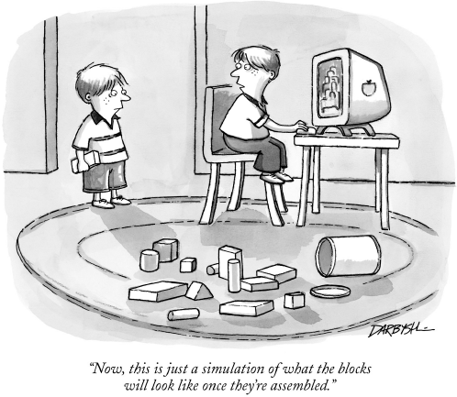
Program Execution
How are programs executed?
"A computer is like a mischievous genie. It will give you exactly what you ask for, but not always what you want." - Joe Sondow

Slide 2

von Neumann Architecture
Major components of a CPU
Program loading and the Instruction Execution Cycle
Variable Addressing
Review Exercise – CPU Simulator

Slide 3
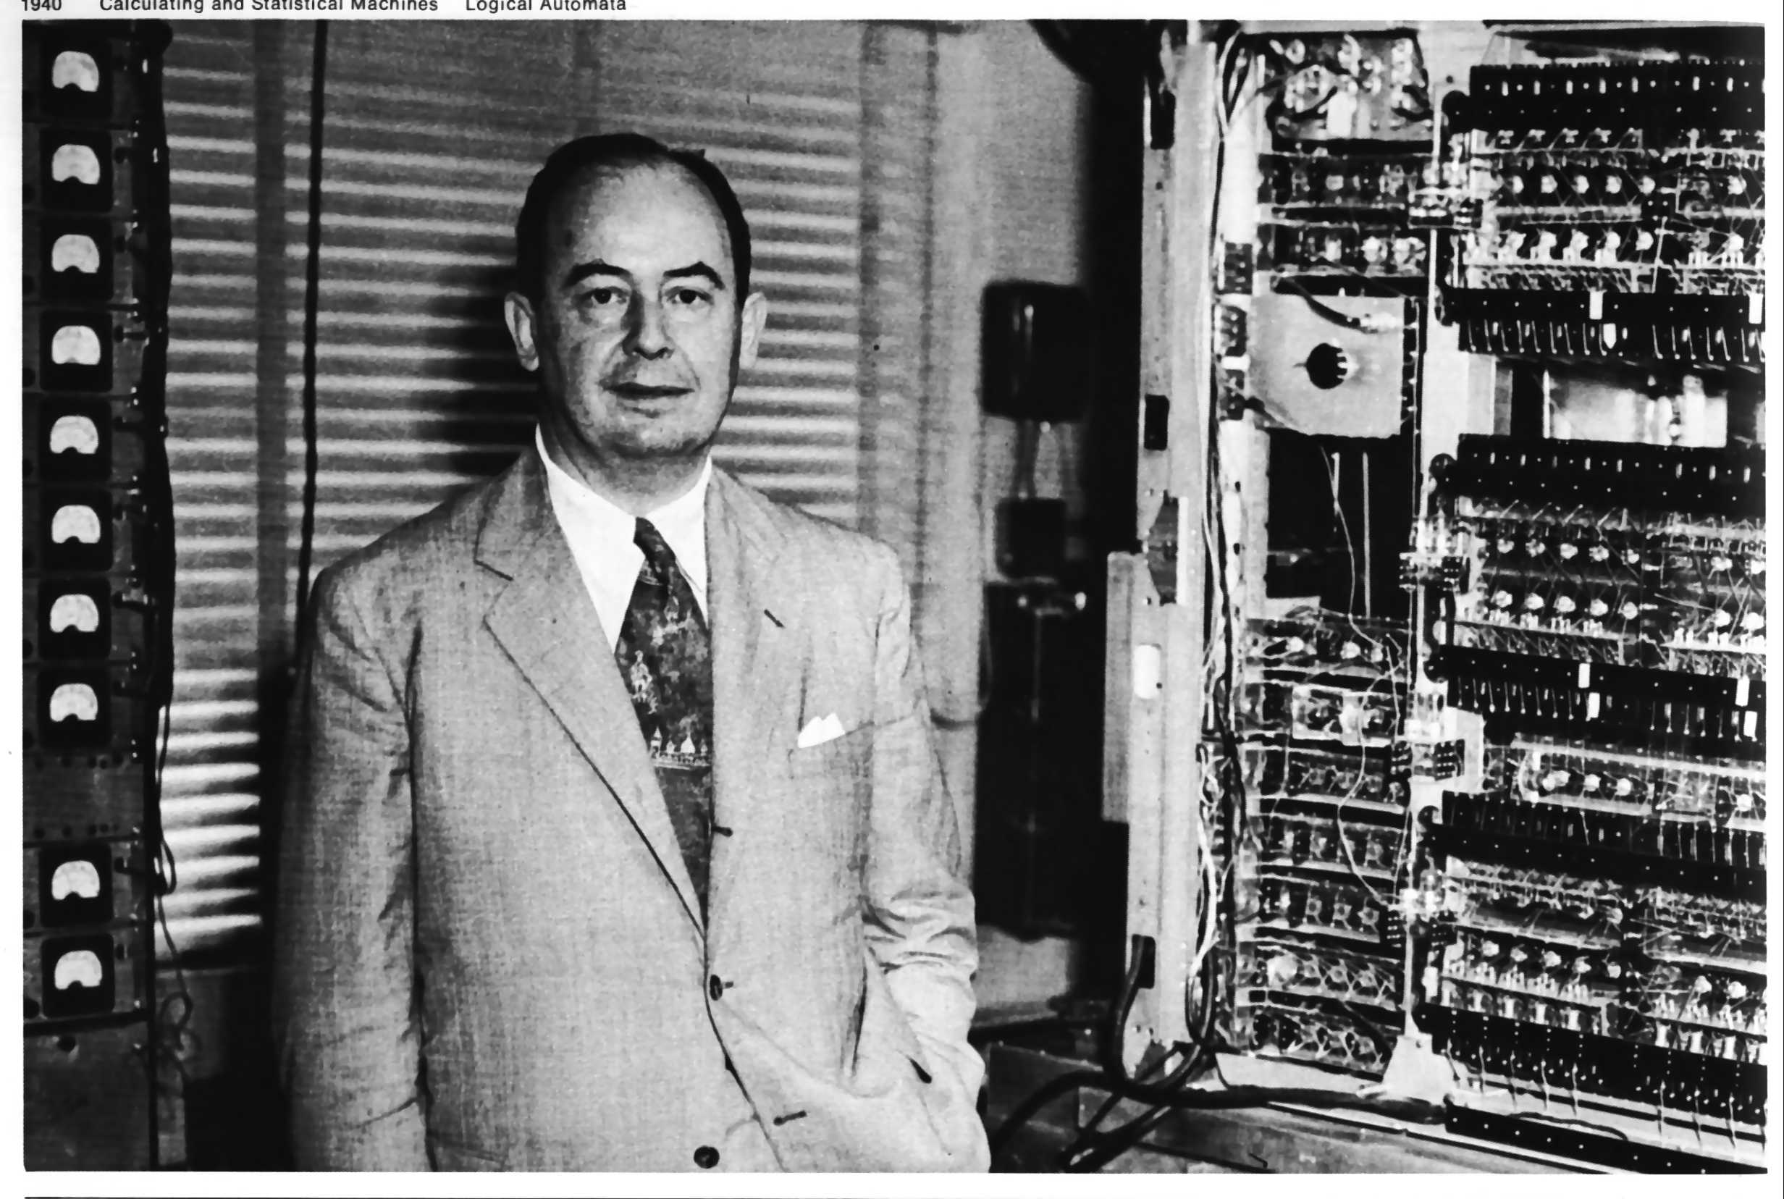
von Neumann Architecture
Historical computers required pre-setting physical switches to encode program and data
von Neumann architecture proposed that program instructions and data could be encoded into memory the same way
Program instructions and data must look the same (Binary) so they can be processed by a Central Processing Unit (CPU)
Harvard Architecture – program instructions and data are located in the same physical memory
Yale Architecture – program instructions and data are in separate physical memory
Modified Harvard Architecture – program instructions and data are placed in separate memory segments in the same physical memory (most modern computers)

Slide 4
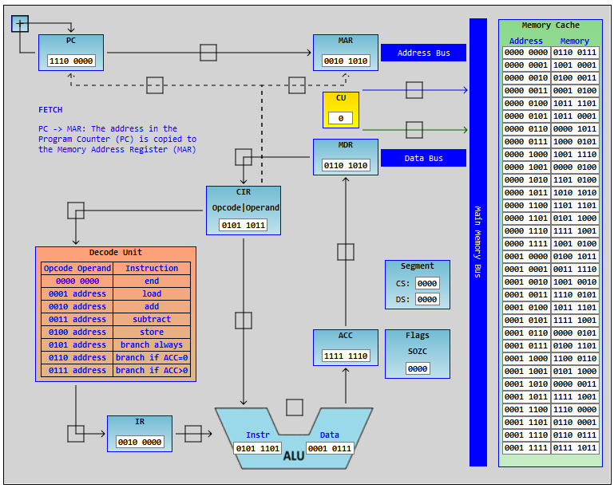
CPU Major Components
Major components
Control Unit
Memory Unit
Decode Unit
Arithmetic Logic Unit
Registers
Loader – load program and data to cache memory
Instruction Execution Cycle
Fetch
Decode
Execute

Slide 5
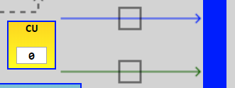
CPU Control Unit
Receives signal from clock (crystal oscillator)
Signals other CPU units to perform operations each clock cycle
Signals main memory bus to read/write data

Slide 6
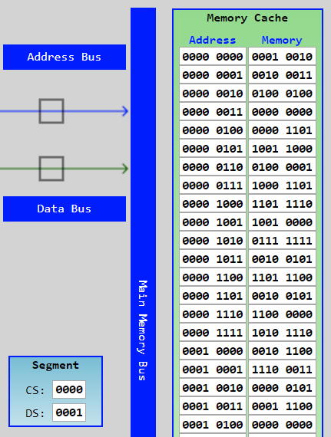
CPU Memory Unit
Cache – super fast RAM memory
Segment registers – hold starting address of code segment (CS) and data segment (DS)
Bus – path of wires wide enough to transmit largest storage size of data in parallel
Main Memory Bus – access cache memory and connect to main system bus
Address Bus – address to load/store data
Data Bus – data value to load/store

Slide 7
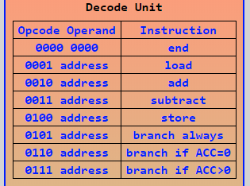
CPU Decode Unit
Translate instruction object code to CPU operation codes (opcode)
Opcodes are specific to a CPU manufacturer and architecture family
Many instructions, such as load, store, add, subtract, etc., include the address of the data to be operated on (data transfer instructions)

Slide 8
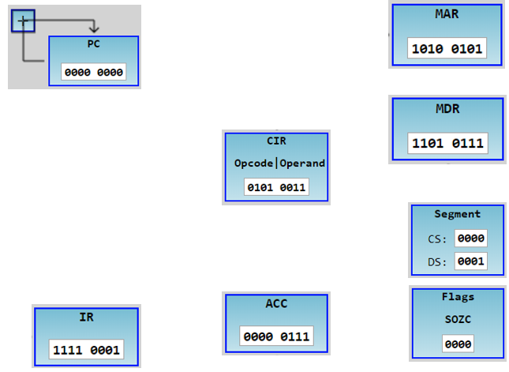
CPU Registers
Small temporary storage locations used for:
addressing instructions and data
transferring and decoding instructions and data
performing arithmetic and logic operations on data
storing results

Slide 9
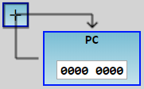
Program Counter Register (PC)
Holds the address of the next instruction to be fetched from cache memory
Register value is incremented immediately after the address value in it is copied to the Memory Address Register as part of each fetch operation
The address in the PC can be replaced with a new value to cause the program to branch to another area of the program, such as in an IF statement or LOOP, or in a function call and return

Slide 10
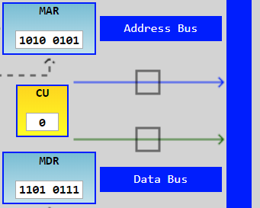
Memory Address (MAR) / Data (MDR) Registers
Memory Address Register (MAR) holds the address of a cache memory block that data should be read from or written to
The address in the MAR is placed onto the Address Bus when the Control Unit signals a read or write to the Main Memory bus
Memory Data Register (MDR) holds the data that is read from cache memory at the address in the MAR, or the data to write to cache memory at the address in the MAR
Data is copied from the cache memory onto the Data Bus and into the MDR when the Control Unit signals the Main Memory Bus for a read
Data is copied from the MDR onto the Data Bus when the Control Unit signals the Main Memory Bus for a write

Slide 11
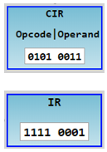
Current Instruction (CIR)/ Instruction (IR) Registers
Current Instruction Register (CIR) holds the both instructions and data for the currently executing instruction
Instructions copied from the MDR to the CIR during a fetch operation contain an opcode for the Decode Unit, and typically the address of any data needed for the operation
Data read from or written to memory as part of an executing instruction overwrites the CIR
Instruction Register (IR) holds the decoded opcode for the currently executing instruction

Slide 12
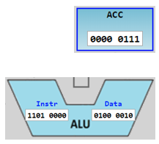
Arithmetic Logic Unit (ALU) / Accumulator(ACC) Register
Arithmetic Logic Unit (ALU) executes opcodes for:
Arithmetic operations: add, subtract, multiply, divide
Logic operations: AND, OR, NOT, SHIFT, and conditional branch instructions
Data Transfer operations: load, store
Accumulator Register (ACC) holds temporary results of arithmetic and logic operations

Slide 13
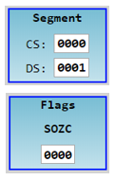
Segment Registers and Flags Register
Segment Registers hold base addresses / offsets of memory segments
Code Segment (CS) holds the base address or offset of where instructions start in cache memory
Data Segment (DS) holds the base address or offset of where data variables start in cache memory
Other segments may include a Stack Segment (SS) and additional Data Segments such as an Extended Segment (ES)
Flags Register holds status indicators for the previous arithmetic or logic operation executed in the ALU
Each bit position in the Flags Register value represent a different status flag where a 1 indicates the last operation in the ALU resulted in a value in the ACC that:
Sign flag (S) – may be a signed number (+/-)
Overflow flag (O) – may be larger than the ACC can hold
Zero flag (Z) – is a zero value
Carry flag (C) – caused a carry out of a 1 in the highest bit or required a borrow of a 1 into the highest bit

Slide 14

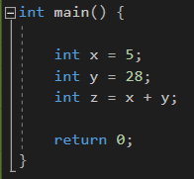
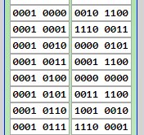

Variable Addressing
Variables are blocks of memory reserved at an offset in a program and address
An offset is a distance from a location. For instance, a variable’s location in memory will be n-bytes from the start of the data segment in a program and memory
The compiler/assembler/loader replaces variable names in instructions with addresses/offsets

Slide 15
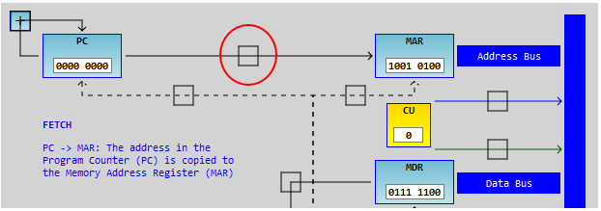
CPU Simulator
Download file “cpusim.zip” from Canvas to a folder on your computer and unzip it
Open file “cpusim.html” in a browser on your PC (Chrome or Firefox work best)
Select Program “Demo” and press the “Load” button
Follow the help directions by clicking on the selection boxes on the connecting arrows between registers
How may clock cycles does the program take?
How may clock cycles do each type of instruction take and why?

Slide 16


Slide 17
What is the key concept of the von Neumann Architecture?
?

Slide 18
Which component of the CPU signals the other components on each clock cycle?
?

Slide 19
Which component of the CPU holds the address of the next instruction to execute?
?

Slide 20
How many clock cycles did the Demo program take?
?

Slide 21
How many clock cycles does an ADD instruction take and why?
?

